Slide 1
Creating and Customizing WSS Sites
Getting Started with SharePoint Customization

Slide 2
Agenda
Architectural overview of SharePoint 2007
Windows SharePoint Services 3.0 (WSS)
Microsoft Office SharePoint Server 2007 (MOSS)
WSS as a collaboration solution
WSS as a server-side development platform
Overview of MOSS components and services

Slide 3
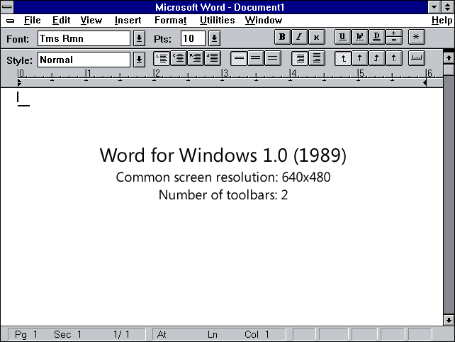
Microsoft Office Through the Ages
It all started off with a modest productivity tool from a medium-sized company in Redmond

Slide 4




Evolution of the Office Power User
VSTO
Smart Tags
.NET Development
COM Development
Visual Basic for Applications (VBA)
Access Basic
Word Basic
Access Macros
Excel Formulas
Word Macros

Slide 5
Office 2003 Server Components
Windows SharePoint Services (WSS v2)
Site and Workspace Provisioning Engine
Accessibility from browser and Office client applications
Out-of-the-box Collaboration Services
MS Office SharePoint Portal Server 2003 (SPS)
Aggregation and search features
Social networking (Profiles, Audiences, My Sites)
Browser Clients
SharePoint Portal Server 2003
Word 2003 Clients
Windows SharePoint Services V2
Outlook 2003 Clients

Slide 6
Evolution of the Web Designer
WSS 3.0 Development
ASP.NET Development
Java Portlets
SharePoint Designer
Cold Fusion
Dream Weaver
FrontPage
ASP Development
JavaScript
CSS
HTML

Slide 7
Student Questionnaire
What's Your Name?
What Company are you with?
How have you evolved as User, Designer and/or Developer?
Office products (Word, Excel, PowerPoint, Outlook)
SharePoint (any version)
Web Design (HTML, CSS, JavaScript)
Development (ASP.NET, WSS 2.0, WSS 3.0, other)

Slide 8
Introducing The Office 2007 System
Windows SharePoint Services 3.0 (WSS)
Licensed as part of Windows Server 2003
Site provisioning engine and core workspace services
Out-of-box collaboration features
A development platform think of WSS as ASP.NET extensions
Microsoft Office SharePoint Server 2007 (MOSS)
Licensed separately under its own SKUs
New components and services built on top of WSS 3.0
Unification of SPS 2003 and CMS 2002
Lots of functionality rolled in beyond SPS and CMS

Slide 9
The WSS 3.0 Server-side Platform
Windows SharePoint Services 3.0 (WSS)
An engine for creating/running/managing sites
Architecture designed to scale to 10,000s of sites
Platform for building Web application and solutions
Collaboration services included out-of-the-box
Browser Clients
WSS Collaboration Services
SQL Server
SQL Server 2005
SQL Server 2000
SQL Express
Office 2007 Clients
Windows SharePoint Services 3.0 (WSS)
Core Site and Workspace Services
Office 2003 Clients
.NET FX 2.0 and ASP.NET 2.0
Internet Information Services 6.0 (or later)
Windows Server 2003 (or later)

Slide 10
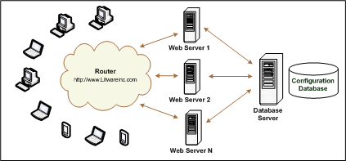
The WSS Farm
WSS deployment based on a farm
Farm requires Web server(s) and database server
Farm can be single server or multi-server
Each farm has exactly one configuration database

Slide 11
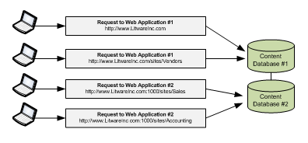
Web Applications
Web Applications provide HTTP entry points
Web Applications based on IIS Web sites
Web Application defines one or more URL spaces
Web Application security configured independently

Slide 12
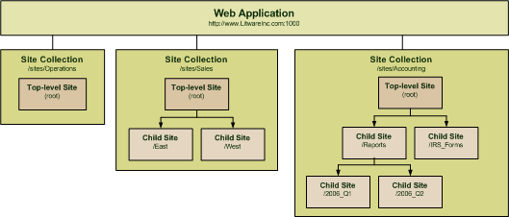
Site Collections and Sites
Sites are partitioned using Site Collections
Site collection is scope for administrative privileges
Site collection always contains top-level site
Site collection may contain hierarchy of child sites
Web application can support 1000s of site collections

Slide 13
Watch Out: Inconsistent Terminology
New Term | Old Term | WSS Object Model
Site Collection | Site | SPSite
Site | Web | SPWeb

Slide 14
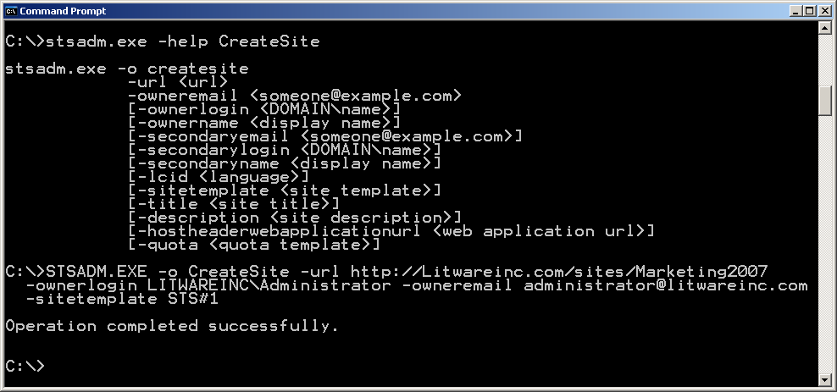
STSADM.EXE Command-line Utility
Useful for running administrative commands
Can be used interactively from command line
Commands can be scripted using batch files

Slide 15
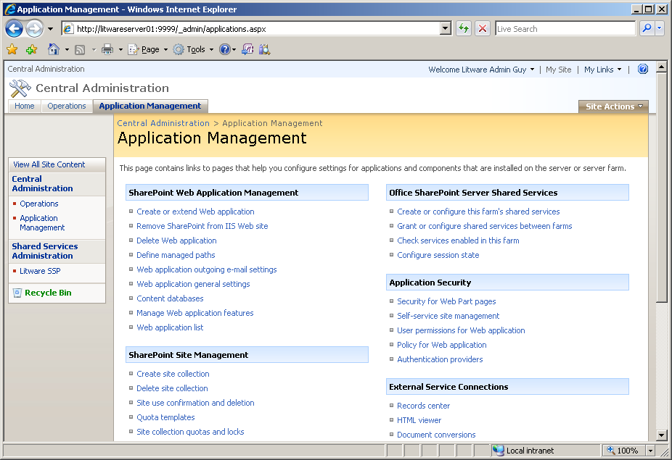
WSS Central Administration (WSS CA)
WSS CA hosted in separate Web Application
Used by farm-level administrators
WSS CA pages have more links if MOSS is installed
Start >
All Programs >
Administrative Tools >
SharePoint 3.0 Central Administration

Slide 16
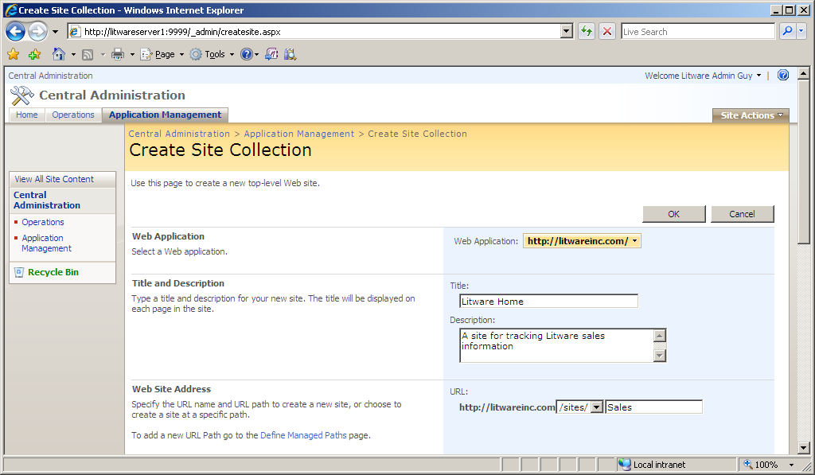
Creating New Site Collections
Steps to provisioning new site collection
Go Application Management tab of WSS CA
Click Link titled Create site collection
Fill out input form and click OK

Slide 17
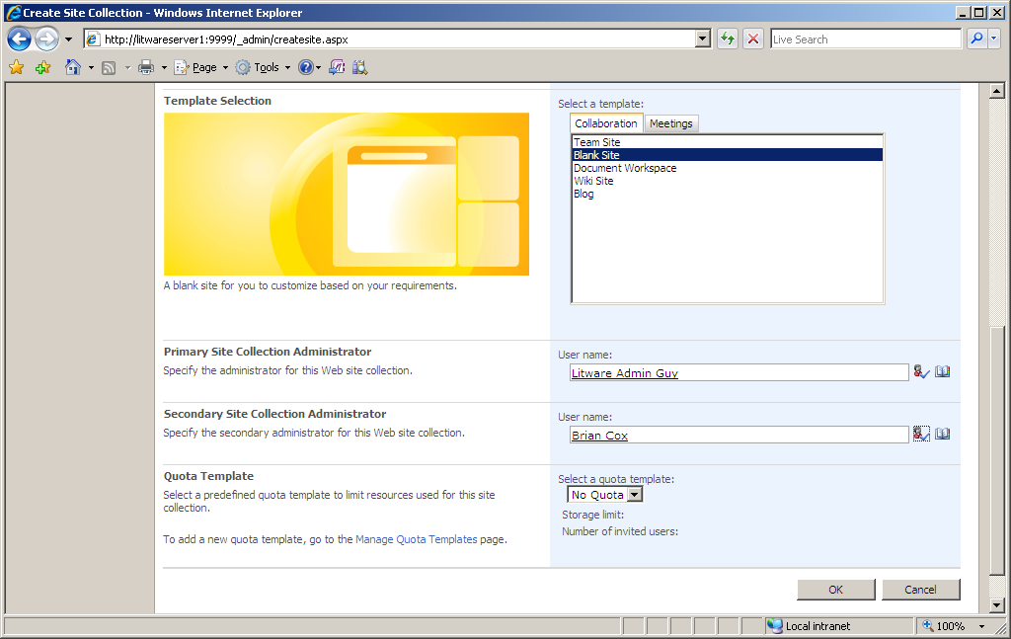
Creating New Site Collections (Part 2)
Important site collection settings
Site template for top-level site
Site collection owner(s)

Slide 18
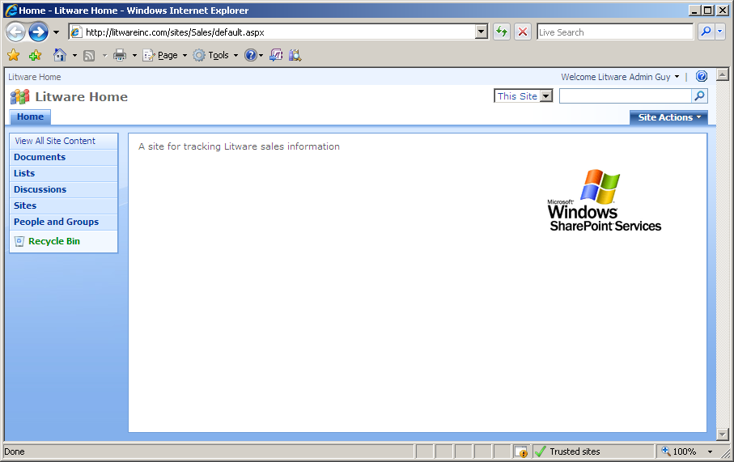
A New WSS Site
New site collection has top-level sites
Site collection owner can provision site elements
Site collection owner can create child sites

Slide 19
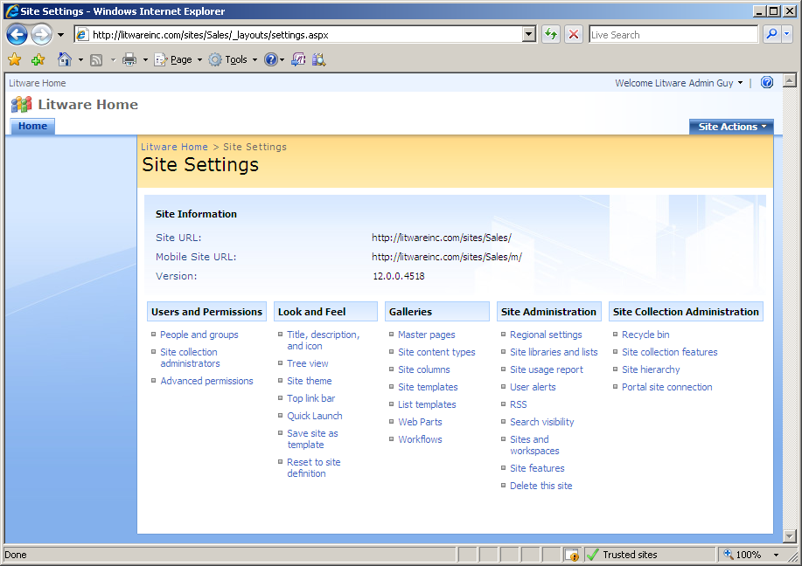
The Site Settings Page
Site Settings accessible via Site Actions menu
Provides links for site and site collection administration

Slide 20
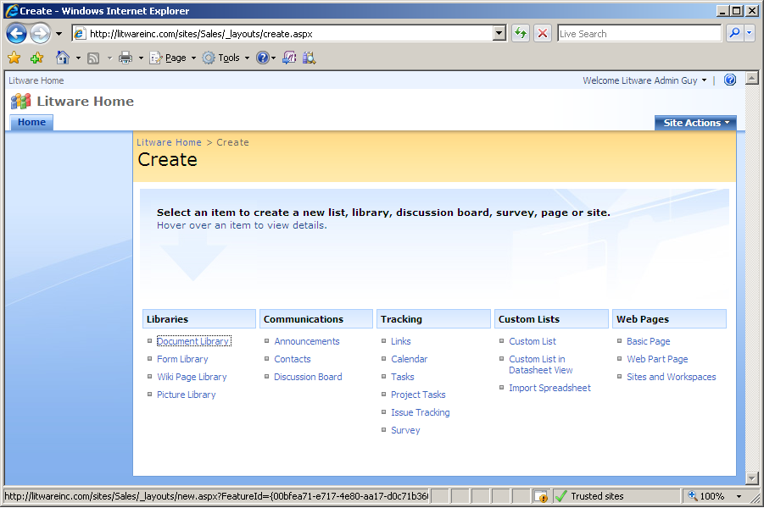
The Create Page
Create page allows provisioning of site elements
WSS provides many collaboration list types out-of-box
You can also provision new pages and child site

Slide 21
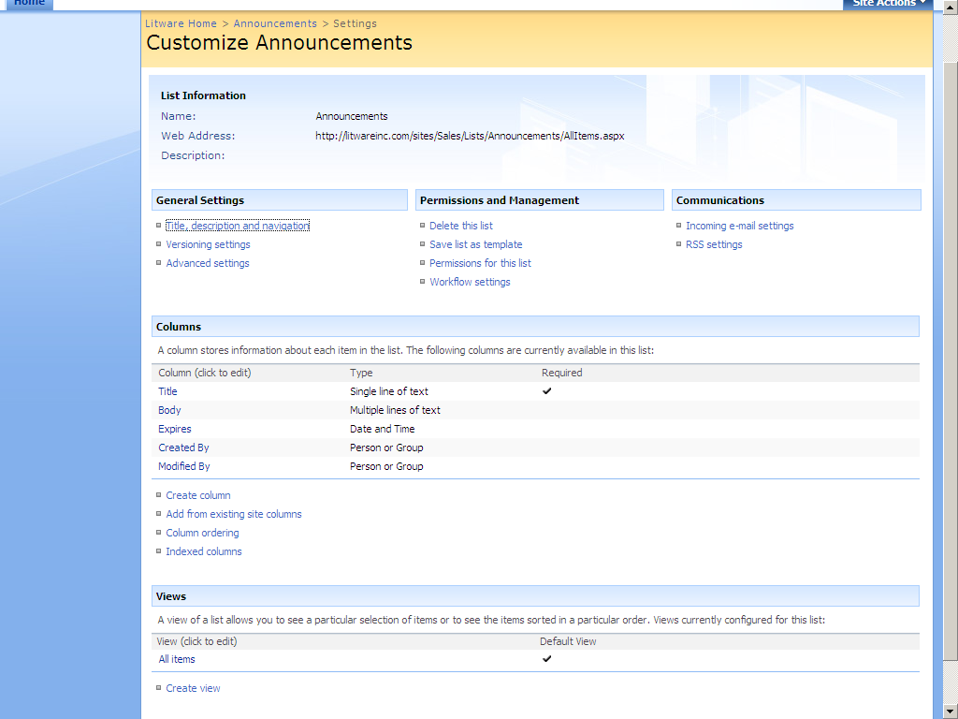
The List Settings Page
Each List Instance provides a Settings Page
You can change list setting and add/remove columns

Slide 22
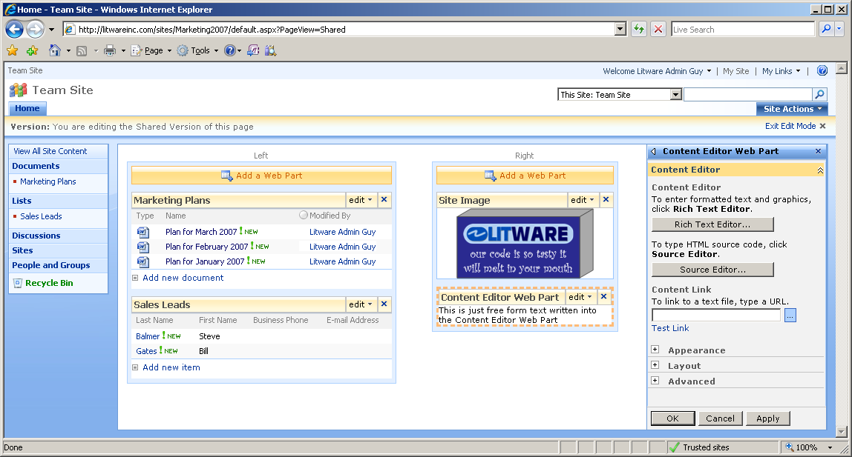
Page Customization using Web Parts
Web Parts provide page-level customization
User can add Web Parts and modify their properties
Web Part support customization and personalization

Slide 23
Customization Versus Development
Site Customizations
Changes to one particular site
Done using the browser or the SharePoint Designer
Changes recorded in content database
Easy to do but hard to reuse
WSS Development
Creation of reusable templates/components
Templates/components installed on Web server
Development based on Visual Studio projects
Project source files checked into source code control
Projects can be moved through staging to production

Slide 24
What is a Feature?
A building block for creating SharePoint solutions
A unit of design, implementation and deployment
Features can contain elements
e.g. menu items, links, list types and list instances
Many other element types possible
Features can contain event handlers
You can add any code which used WSS object model

Slide 25
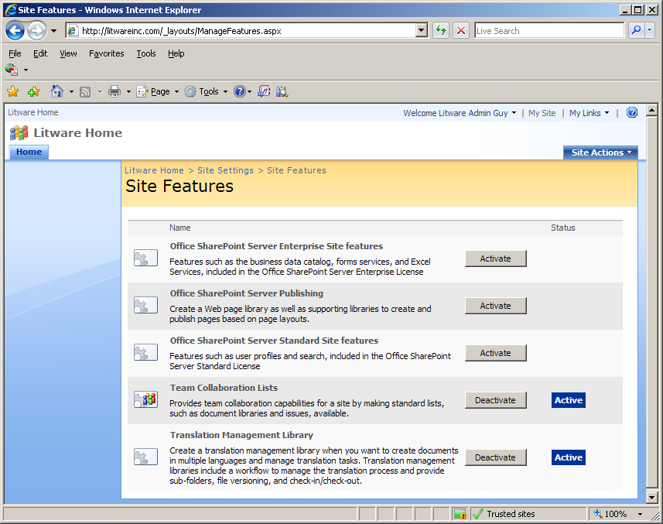
User’s View of Features
Features support concept of activation/deactivation
This is the site-level feature management page in a WSS farm where MOSS has been installed.
Much of the functionality of MOSS is enabled and disable by activating and deactivating features that have been developed by the MOSS team.

Slide 26
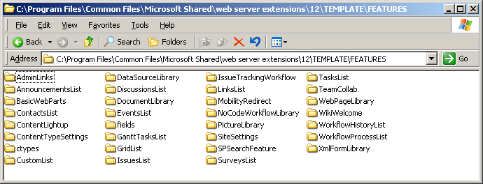
The Features Directory
Functionality in WSS based on Features
Features are installed at farm level
Feature activation makes functionality available
WSS supports for different feature activation scopes
(1) Site (2) Site Collection (3) Web Application (4) Farm
Your custom features will each need a directory created here

Slide 27
Customization Versus Development
Site Customizations
Changes to one particular site
Done using the browser or the SharePoint Designer
Changes recorded in content database
Easy to do but hard to reuse
WSS Development
Creation of reusable templates/components
Templates/components installed on Web server
Development based on Visual Studio projects
Project source files checked into source code control
Projects can be moved through staging to production

Slide 28
Microsoft Office SharePoint Server 2007
Microsoft Office SharePoint Server 2007 (MOSS)
Components and services built on WSS 3.0
Browser Clients
Microsoft Office SharePoint Server 2007 (MOSS)
Value-added Applications and Services Built on WSS 3.0
Office 2007 Clients
Office 2003 Clients
Windows SharePoint Services 3.0 (WSS)
Core Site and Workspace Services
.NET FX 2.0 and ASP.NET 2.0
Internet Information Services 6.0 (or later)
Windows Server 2003 (or later)

Slide 29
MOSS Services and Components
What does MOSS Standard Edition provide?
Next-generation features of SPS 2003 (Portal)
Next-generation features of CMS 2002 (WCM)
What does MOSS Enterprise Edition provide?
Forms Services
Business Data Catalog
Excel Services

Slide 30
Portal and Search
MOSS includes next-generation of SPS features
User profiles, audience targeting and MySites
Enterprise search
Introduces Business Data Catalog
MOSS
Active Directory
Information
Browser Clients
Active Directory
Integration
Personal Profiles
and Document Storage
Word 2007 Clients
My Sites
Corporate
File Shares
Excel 2007 Clients
Enterprise
Search
WSS Team Sites
Outlook 2007 Clients
Business Data
Catalog
Line of Business Apps
SAP | Seibel | PeopleSoft | Other

Slide 31
InfoPath 2007 and Forms Services
InfoPath 2003
Capture business data with dynamic, XML-based forms
Rich data entry and validation
Integration with back-end LOB systems
InfoPath 2007 and Forms Services
Ability to push InfoPath forms to browser-based clients
Integration with Office 2007 client applications

Slide 32
SharePoint 2007 Workflows
WSS and MOSS provide rich workflow support
Support built on Windows Workflow Foundation (WF)
WSS provides development platform for workflows
MOSS provides several valuable workflows out-of-box
Create
Document
Edit /
Review
Ready to publish,
sign off & approve
Publish

Slide 33
Web Content Management
WCM features designed for public Web sites
Core CMS features integrated into MOSS
Features for site branding and customized page layouts
Profession publishing features for content approval
Customers
Office Server
Production Web Site
Vendors
Shareholders
3
Content Author
Office Server
Staging Web Site
1
Content Approver
2

Slide 34
Business Intelligence
The MOSS Vision for Business Intelligence (BI)
Provide business insight to all employees
Lead to better, faster, more relevant decisions
Integrate with BI features of SQL Server and Excel
Browser
MOSS BI Features
Excel Services
Word 2007
Report Center
Outlook 2007
Dashboards
Excel 2007
SQL Server 2005
Analysis Services | Reporting Services

Slide 35
Schedule of Lectures
Creating and Customizing WSS Sites <<< (you are here)
Lists, Document Libraries and Content Types
Introduction to SharePoint Designer 2007
Creating Corporate Portal Sites
User Profiles, MySites and Audience Targeting
Configuring and Extending Search
InfoPath 2007 and Forms Services
Workflow and Process Management
Web Content Management using Publishing Portals
Leveraging the Business Data Catalog
Publishing Spreadsheets with Excel Services
Creating Dashboards with Report Center

Slide 36
Summary
Architectural overview of SharePoint 2007
Windows SharePoint Services 3.0 (WSS)
Microsoft Office SharePoint Server 2007 (MOSS)
WSS as a collaboration solution
WSS as a server-side development platform
Overview of MOSS components and services

